Slide 1
inter-process communication, process synchronization, Concurrency, critical section, mutual exclusion, SEMAPHORES AND MUTEX LOCK
Week#08

Slide 2
Types of Processes
Independent process
Co-operating process

Slide 3
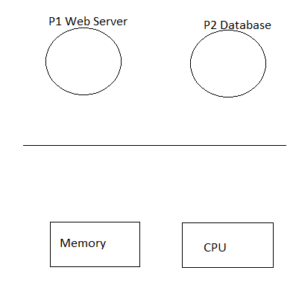
Can Processes Interact
Consider a web application with two processes
A web server
A database
These processes communicate
with the help of IPC Mechanisms

Slide 4
Inter-process Communication Mechanisms (IPC)
Transfer data/info between address spaces
Still maintaining protection and isolation
Provide flexibility and performance

Slide 5
IPC Methods
Processes can communicate with each other through both: Methods of IPC
Shared Memory
Message Passing

Slide 6
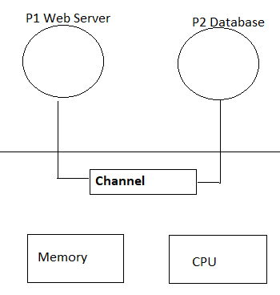
Message Passing
IPC Mechanism
OS provides communication channel like a shared buffer
Processes
Send()
Receive()
Messages to and from channel

Slide 7
Message Passing
Advantage
OS manages communication hence, standard APIs and system call functions are used.
Disadvantage
Overhead – Copying messages between uses space and kernel space

Slide 8
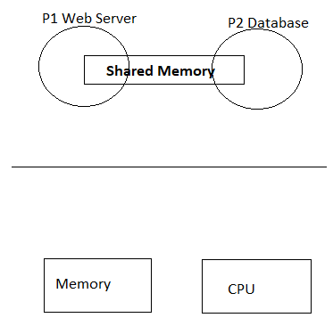
Shared Memory
IPC Mechanism
OS establishes a shared channel and maps it into address space of each process
Process directly read/write from this memory
OS is out of the way!

Slide 9
Shared Memory
Advantage
OS is out of the way – no copying of messages between user and kernel space
Disadvantage
No standard APIs or System call; Processes must implement their own code

Slide 10
Concurrency
Concurrency is the computation of processes in such a way that either they are actually executing simultaneously or at least give an impression of simultaneous execution.
The central themes of operating system design are all concerned with the management of processes and threads:
Multiprogramming:
The management of multiple processes within a uniprocessor system.
Multiprocessing:
The management of multiple processes within a multiprocessor.
Distributed processing:
The management of multiple processes executing on multiple, distributed computer systems.

Slide 11
Concurrency
Concurrency arises in:
Multiple applications
Sharing time
Structured applications
Extension of modular design
Operating system structure
OS themselves implemented as a set of processes or threads
Notes:
• Multiple applications:
Multiprogramming was invented to allow processing time to be dynamically shared among a number of active applications.
• Structured applications:
As an extension of the principles of modular design and structured programming, some applications can be effectively programmed as a set of concurrent processes.
• Operating system structure:
The same structuring advantages apply to systems programs, and we have seen that operating systems are themselves often implemented as a set of processes or threads.

Slide 12
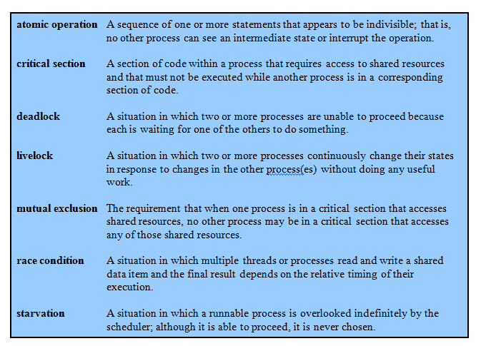
Key Terms

Slide 13
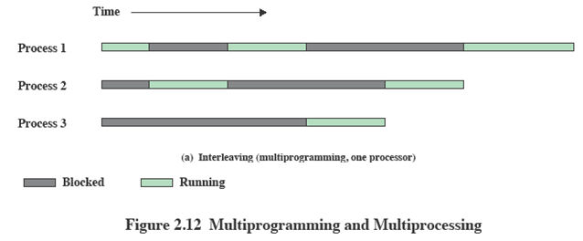
Interleaving and Overlapping Processes
Earlier we saw that processes may be interleaved on uniprocessors

Slide 14
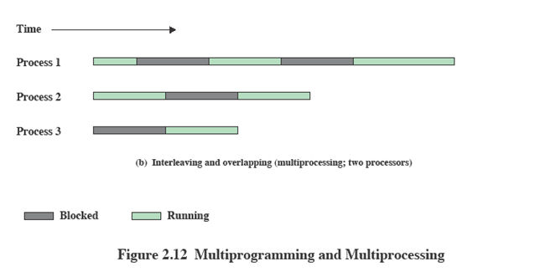
Interleaving and Overlapping Processes
And not only interleaved but overlapped on multi-processors

Slide 15
Difficulties of Concurrency
Sharing of global resources
Optimally managing the allocation of resources
Difficult to locate programming errors as results are not deterministic and reproducible.
Notes:
The sharing of global resources
If two processes both make use of the same global variable
and both perform reads and writes on that variable,
then the order in which the various reads and writes are executed is critical.
Managing Resources
It is difficult for the OS to manage the allocation of resources optimally.
E.G. A process may request use of, and be granted control of, a particular I/O channel and then be suspended before using that channel.
It may be undesirable for the OS simply to lock the channel and prevent its use by other processes;
indeed this may lead to a deadlock condition,
Locating Programming Errors
It becomes very difficult to locate a programming error because results are typically not deterministic and reproducible

Slide 16
A Simple Example
void echo()
{
chin = getchar(); //get input
chout = chin;
putchar(chout); //Display value
}
A program that will provide a character echo procedure;
input is obtained from a keyboard one keystroke at a time.
Each input character is stored in variable chin.
It is then transferred to variable chout and finally sent to the display.
Any program can call this procedure repeatedly to accept user input and display it on the user’s screen.
Each application needs to use the procedure echo,
So it makes sense for it to be a shared procedure that is loaded into a portion of memory global to all applications.
Thus, only a single copy of the echo procedure is used, saving space.

Slide 17
A Simple Example: On a Multiprocessor
Process P1 Process P2
. .
chin = getchar(); .
. chin = getchar();
chout = chin; chout = chin;
putchar(chout); .
. putchar(chout);
. .
The result is that the character input to P1 is lost before being displayed, and the character input to P2 is displayed by both P1 and P2.

Slide 18
Race Condition
A race condition occurs when
Multiple processes or threads read and write data items
They do so in a way where the final result depends on the order of execution of the processes.
The output depends on who finishes the race last.

Slide 19
Operating System Concerns
What design and management issues are raised by the existence of concurrency?
The OS must
Keep track of various processes
Allocate and de-allocate resources
Protect the data and resources against interference by other processes.
Ensure that the processes and outputs are independent of the processing speed

Slide 20
Need for Mutual Exclusion
Mutual Exclusion: Requirement that when one process in critical section then no other process can be in the same critical section
Suppose two or more processes require access to a single non sharable resource, such as a printer.
During the course of execution, each process will be sending commands to the I/O device, receiving status information, sending data, and/or receiving data.
We will refer to such a resource as a critical resource, and the portion of the program that uses it a critical section of the program.
It is important that only one program at a time be allowed in its critical section.
We cannot simply rely on the OS to understand and enforce this restriction because the detailed requirements may not be obvious.
In the case of the printer, for example, we want any individual process to have control of the printer while it prints an entire file.
Otherwise, lines from competing processes will be interleaved.

Slide 21
Critical Section
Critical Section: The section of code where shared resources are accessed is called Critical Section and that resource is called critical resource.
Critical Section Properties:
It must have mechanism for mutual exclusion
A thread outside critical section cannot stop another thread from entering it
Bounded waiting - A process remains inside its critical section for a finite time only
These are also requirements for mutual exclusion
There must be some mechanisms for implementing mutual exclusion

Slide 22
Example
void echo()
{
//Critical Section Entry
chin = getchar(); //get input
chout = chin;
putchar(chout); //Display value
// End of Critical Section
}

Slide 23
Process Synchronization
Process Synchronization is defined as a mechanism which ensures that two or more concurrent processes do not simultaneously execute critical section.
When one process starts executing the critical section the other process/thread should wait.

Slide 24
MUTEX Locks – Process Synchronization tool
A locking mechanism used to synchronize access to a resource
Only one process/thread can acquire the mutex lock
And the process that acquires it has the authority to release it
When the process is enters the critical section it acquires the lock an changes the value of the lock to be 1 or true
When the process leaves the critical section, it releases the lock changing its value to 0 or false.
Other processes waiting for the lock to be released continuously tests the value of the lock to see if the value has been changed, hence wasting CPU time. This phenomenon is called Busy Waiting.
And due to this, mutex locks are also called Spin Locks

Slide 25
Example
void echo()
{
aquire_lock() //Critical Section Entry
chin = getchar(); //get input
chout = chin;
putchar(chout); //Display value
release_lock() // End of Critical Section
}

Slide 26
Semaphore – Process Synchronization tool
An integer value used for signalling among processes.
Only three operations may be performed on a semaphore, all of which are atomic:
Initialize() - A semaphore may be initialized to a nonnegative integer value (No: of resources of the same type).
Decrement (semWait)
The semWait operation decrements the semaphore value.
If the value becomes negative, then the process executing the semWait is blocked.
Otherwise, the process continues execution.
Increment (semSignal)
The semSignal operation increments the semaphore value.
a process blocked by a semWait operation, if any, can be unblocked by this function.
Notes:
1.

Slide 27
Types of Semaphore
Binary Semaphore
If the value of semaphore is initialized with 1 then it behaves same as mutex locks and is called binary semaphore
Counting Semaphore
If the value of semaphore is initialized with value greater than1 then it is called counting semaphore

Slide 28
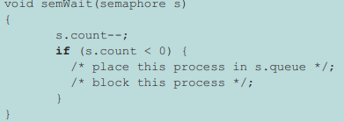
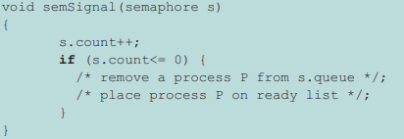
Counting Semaphore
Entry code: Wait
Exit code: Signal

Slide 29
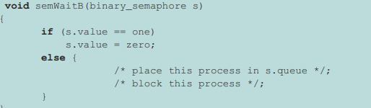
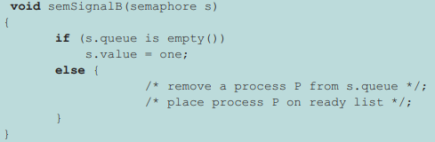
Binary Semaphore
Entry code: Wait
Exit code: Signal

Slide 30
Mutex vs Semaphore
Mutex has the problem of busy waiting which does not exist with semaphores
Semaphores can be used to incorporate mutual exclusion when no: of resources are greater than 1.

Slide 31
Thank You!

